Slide 1


Slide 2





TWOS
Checkpoint 1 (Week 4-5)
Capstone Project: Checkpoint 1
Umair, Sangmin, Ayo
Notes:
Good Morning
We are Team TWOS
Umair, Sangmin, and Ayo.
Our project is AI-based Travel Companion
Travel Without Stress (TWOS).
It’s an intelligent platform that plans your entire trip
Flights, hotels, rentals, and attractions
All in one chat.

Slide 3
References
FastAPI. (n.d.). https://fastapi.tiangolo.com/
Gemini API | Google AI for Developers. (n.d.). Google AI for Developers. https://ai.google.dev/gemini-api/docs?_gl=1*10ikmno*_up*MQ..&gclid=CjwKCAjwiNXFBhBKEiwAPSaPCZwtSrEfGWXWv4V0wlEhPymF368axJBUUaK1Zt5pY8yoqw2DDUmD7BoC7
OpenAI. (2021, November 12). OpenAI API. OpenAI. https://openai.com/api/
TcQAvD_BwE&gclsrc=aw.ds&gbraid=0AAAAACn9t64vSgeSxG9ZQw6Z2w5wRLzK5
React Native · Learn once, write anywhere. (n.d.). https://reactnative.dev/
Swagger-Api. (n.d.). GitHub - swagger-api/swagger-ui: Swagger UI is a collection of HTML, JavaScript, and CSS assets that dynamically generate beautiful documentation from a Swagger-compliant API. GitHub. https://github.com/swagger-api/swagger-ui
The PostgreSQL Global Development Group. (2025). PostgreSQL: Documentation. Www.postgresql.org. https://www.postgresql.org/docs/
https://dev.to/gbengelebs/netflix-system-design-backend-architecture-10i3
‌
Created by Umair, Sangmin, Ayo
Notes:
Here are our references for the project

Slide 4



Roles for Team Members
Sangmin Lee
Python, JS, Docker, Kubernetes
Key Responsibilities
Build NLU clarifier logic
Track and maintain slot-filling states
Optimize options based on rank/score
Create an explanation
Umair Dada
React Native Specialist, Node.js, Express
Key Responsibilities
Lead team & milestones
Build React Native app
Manage Node.js gateway
Handle testing & demo
Ayomika Ajibade
FastAPI, Database & API Design, Cloud Integration
Key Responsibilities
Design API schema
Create databases for local & prod
Integrate and scale Al solutions for the mobile app
Created by Umair, Sangmin, Ayo

Slide 5
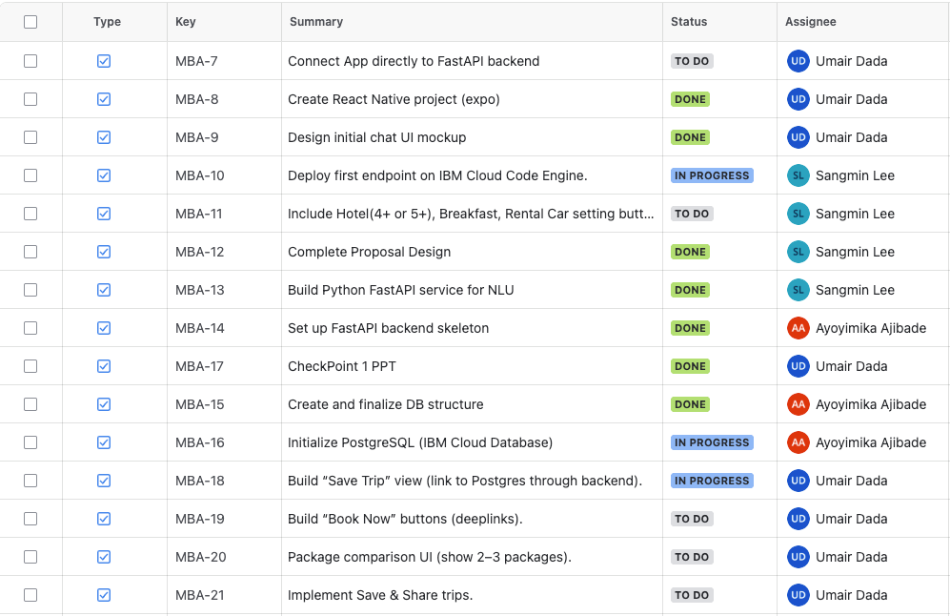
Progress #1 - Project Tracking (JIRA)
We are using JIRA because it is one of the most widely used project management tools in the software industry.
Working with JIRA gives us real-world experience in agile task tracking, sprint planning, and collaboration, helping us become familiar with the same workflows and tools used by professional development teams.
This also prepares us for internships and jobs where JIRA is the industry standard.
Created by Umair

Slide 6
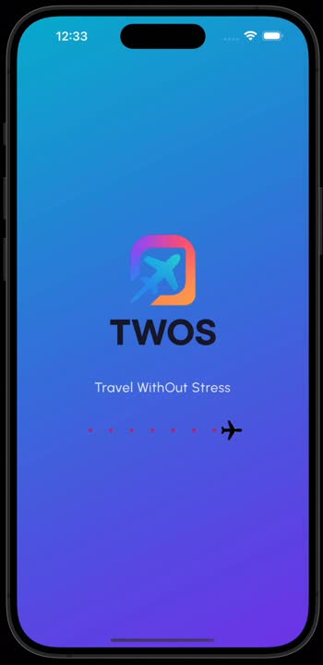
Progress #2 - Frontend
Create React Native project (expo)
We created the TWOS app using Expo, with navigation, gradient design, and a clean structure. It already supports state management and mock API calls so the UI works smoothly before backend integration.
Design initial chat UI mockup
We designed a Gen-Z chat screen with bubbles, quick chips, and package previews. Here’s a short screen recording showing the first user flow—it’s a working mock with sample data while backend work continues.
Created by Umair

Slide 7
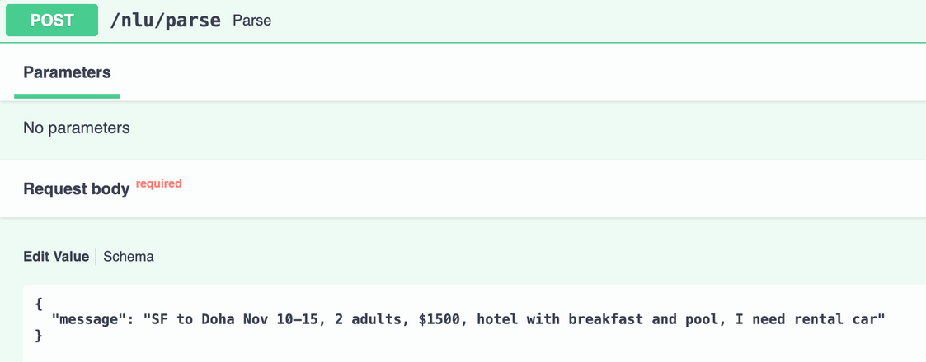
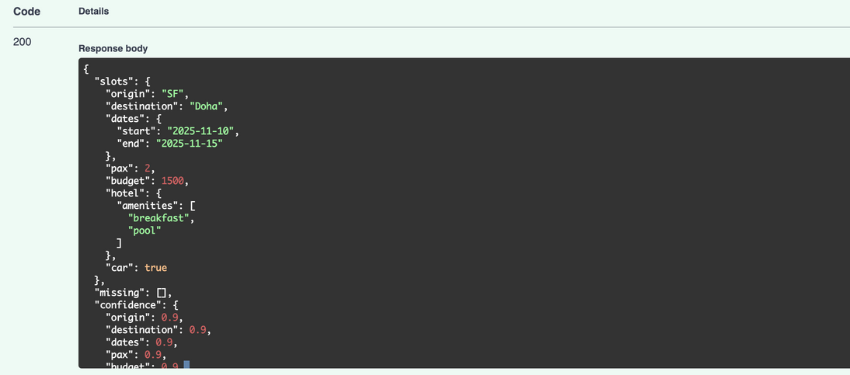
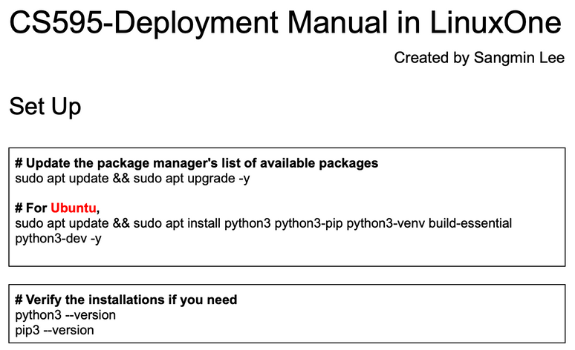
Progress #3 - NLP
Build Python FastAPI service for NLP
This service will take the user’s natural language and extract entities for planning.
Essential entities: origin, destination, dates, pax, budget, hotel amenities
Option entity: Rental Car
Deploy FastAPI server in IBM LinuxOne
The Deployment Manual has been created
Firewall configuration is done, but can’t reach it
from the local browser. Maybe LinuxOne issues
Created by Sangmin
Notes:
(Sangmin)
Thank you Umair,
Here is our 3rd progress.
We built the NLP service using FastAPI.
This service takes the user's natural language information and extracts entities for planning.
We made these(from origin to hotel amenities) as essential entities, and the car as an option entity.
Also, we started to set up the deployment in the LinuxOne community cloud.
The deployment manual has been created, and we are updating it if there is any progress.
One problem we have is that we finished firewall configuration and checked that the ports are active, but we were not able to ping the server from the local browser; it could be LinuxOne's issue, so we sent an email and are waiting for LinuxOne.

Slide 8
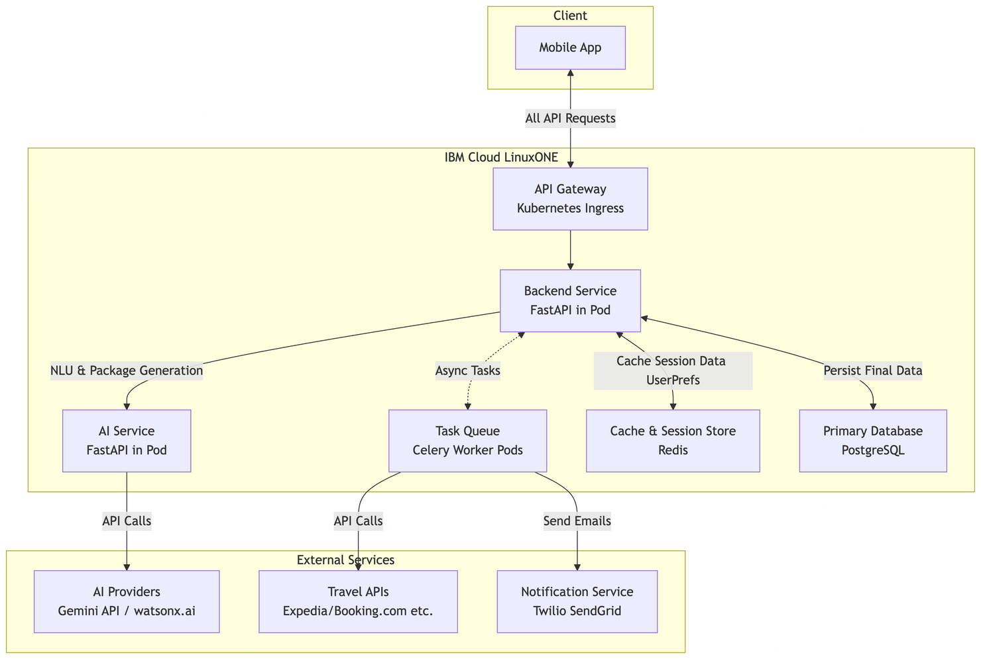
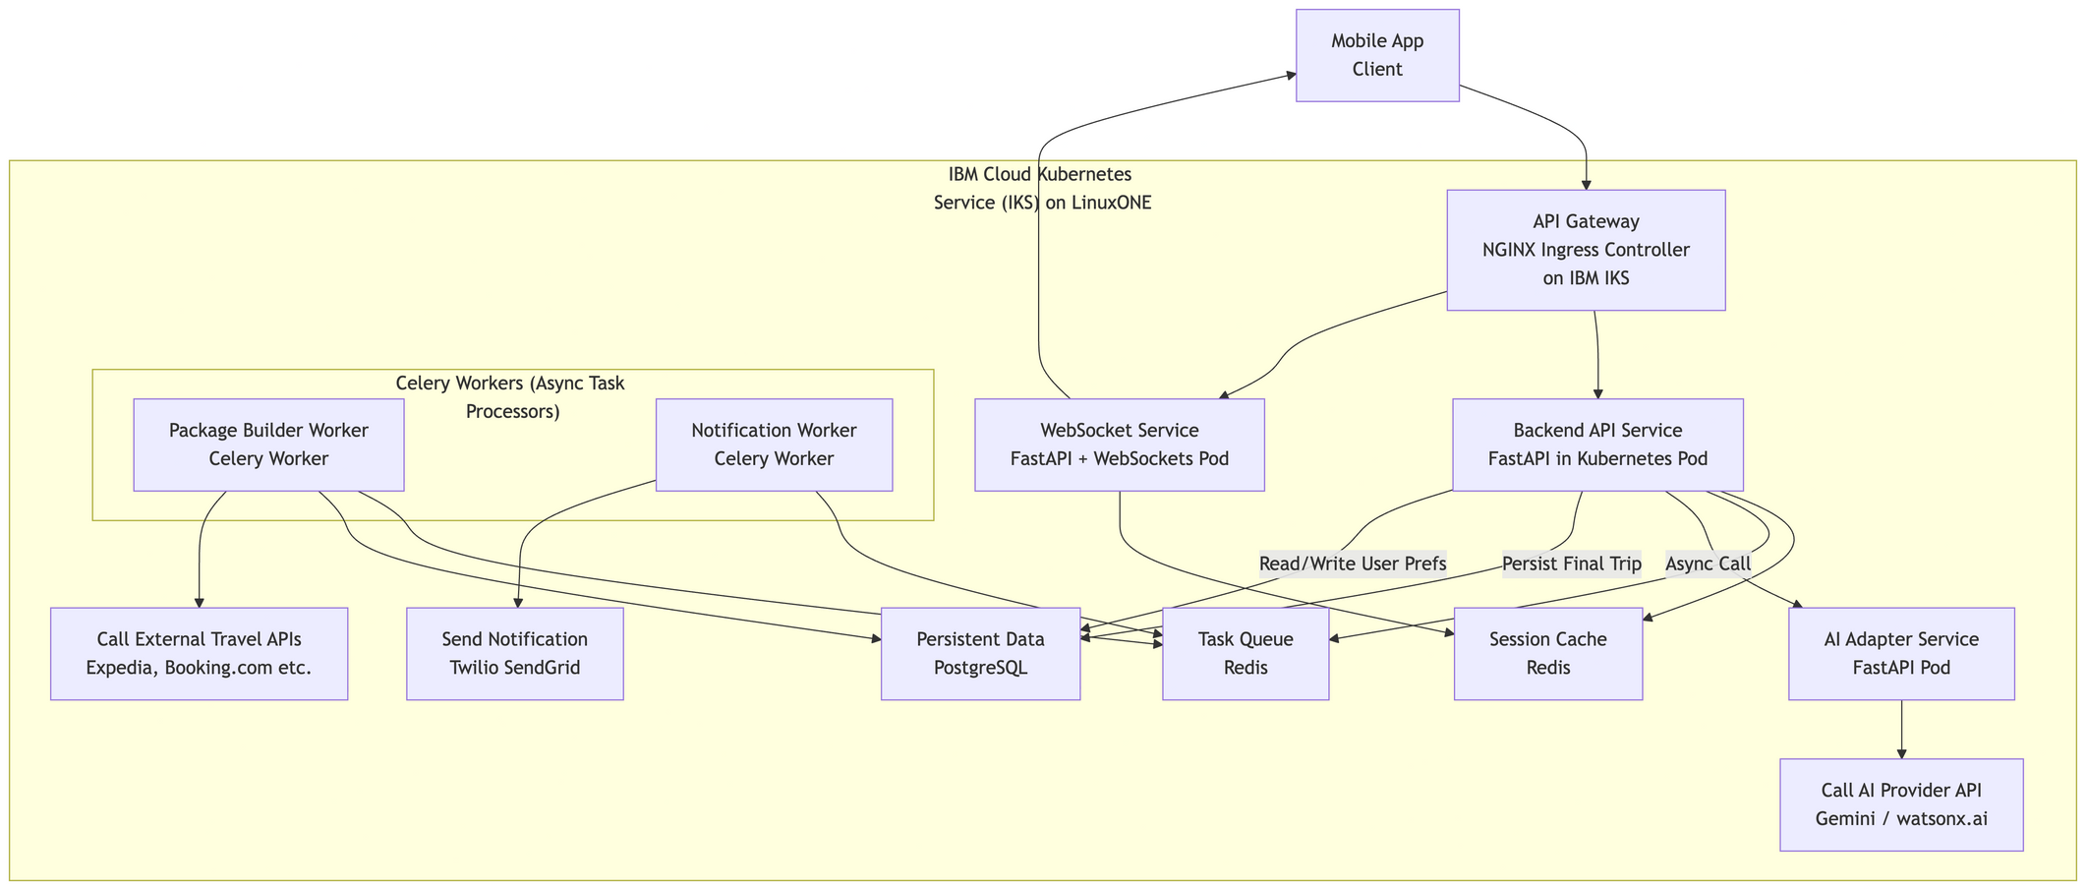
Progress #4 - Backend Architecture
Design backend architecture
The proposed architecture is designed for scalability and low latency, leveraging microservices principles.
Design Low-level system architecture
The diagram illustrates the precise components, their technologies, and the data flow for a primary user interaction: processing a chat message and returning travel packages.
Created by Ayo

Slide 9
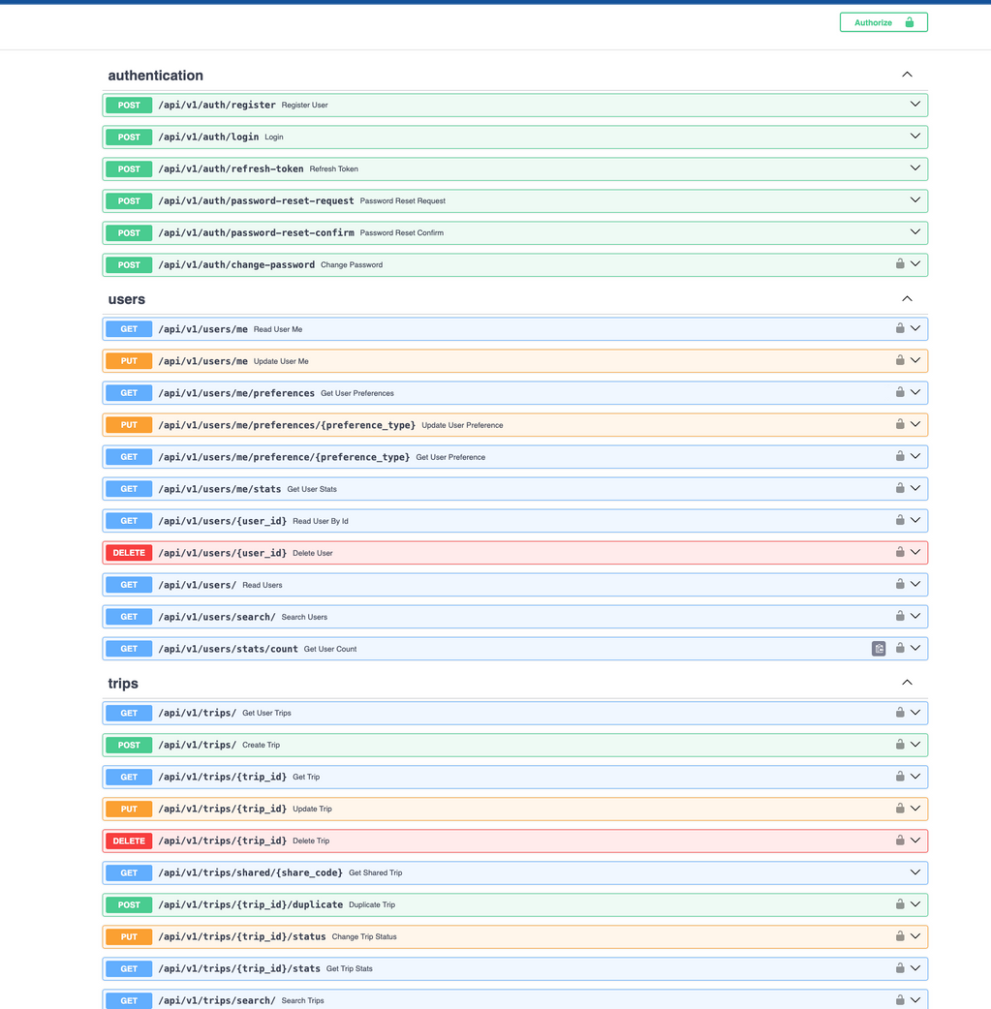
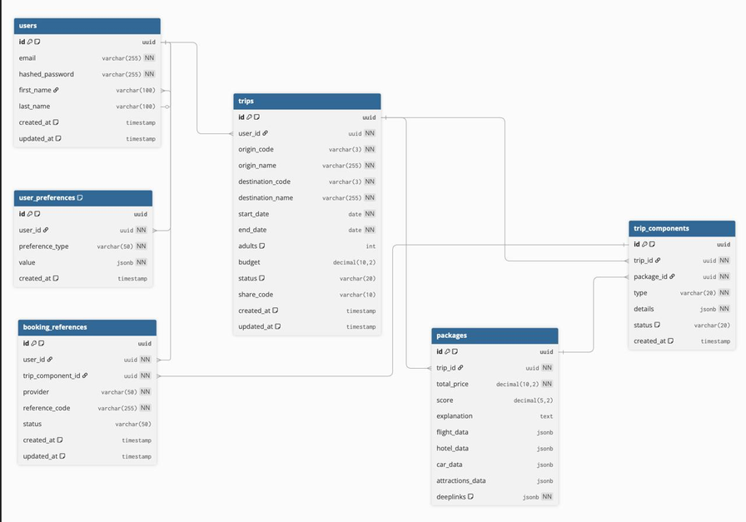
Progress #5 - Database & API
Set up FastAPI backend skeleton
FastAPI is organised around RESTful principles for resources and uses WebSockets for real-time features. like authentication, bookings, trip, packages CRUD functionality
Create and finalize DB structure
The schema utilizes a relational model with PostgreSQL JSONB columns for flexibility with external API data, including users, trips, trip components tables, indexing frequently accessed rows, data validation, and more.
Created by Ayo

Slide 10
Project Timeline
Proposal and Setup
LLM + Chat Setup
Rent & Attractions Integration
Publish & Deployment
Prepare the project proposal and set up the development environment
Integrate LLM API, API, implement classification slots, and create chat endpoints
Integrate APIs for car rental, hotels and attractions search, and add an API endpoint
Publish an app to the Expo/Vercel
Week 1-3
Week 4-5
Week 6-7
Week 8-9
Week 10-11
Week 12-13
Week 14
Frontend & backend Setup
Flights & Hotels Integration
Orchestration & Testing
Initialize and design the frontend basic layout and the backend basic endpoints
Integrate APIs for flights and hotels, and add each API endpoint
Orchestrate flight, hotel, rental, and attractions based on inputs
Created by Sangmin, Umair, Ayo
Notes:
(Sangmin)
Ok, here is our timeline
We are a little ahead of our plans. We finished the setups and are working on LLM and also deployment at the same time.

Slide 11
What’s next?
Connecting Frontend and Backend
Goal: Make the chatbot work
Expected Result #1: The chatbot checks the slots and gets essential information based on the in-app database.
Expected Result #2: Send collected data to LLM and get the necessary information for APIs
Connecting APIs (Hotel, Rental Car, Google Search)
Goal: Call APIs to get a list of options using information from the user and the LLM
Expected Result #1: List of flights from origin to destination on the user’s dates, flight type and ticket options (Round-trip, Non-stop).
Expected Result #2: List of hotels at the destination on the user’s dates with the user’s preferred amenities.
Created by Sangmin, Ayo, Umair
Notes:
(Sangmin)
Ok. Thank you, Ayo
Here are our goals for the next two weeks.
First, we have wonderful frontend and backend assets, and it's time to make the chatbot work.
We expect our AI service to extract and track the essential information from users.
Second, based on the extracted information, we reconstruct it and provide it to the required APIs, and expect responses from them.

Slide 12
What’s next?
Fix LinuxOne Cloud access
Goal: Make available access to the server running in the LinuxOne cloud
Expected Result #1: Developers can access SwaggerUI from their local browser
Expected Result #2: Developers can test user input
Created by Sangmin
Notes:
(Sangmin)
Lastly, we need to fix the LinuxOne Cloud issue. Hope we can get a reply back from LinuxOne ASAP, and see what the problem is, so we can fix it.
And this is what we prepared for today. Thank you all!

Slide 13
THANK YOU
twos
Created by Umair, Sangmin, Ayo
Notes:
Thank you for your attention.
We’re excited to present TWOS, a smarter way to travel.
We’ll now open the floor for any questions.

